Slide 1
REST API, Web Scraping & Working with different File Formats
REST APIs & HTTP Requests – Part 1

Slide 2
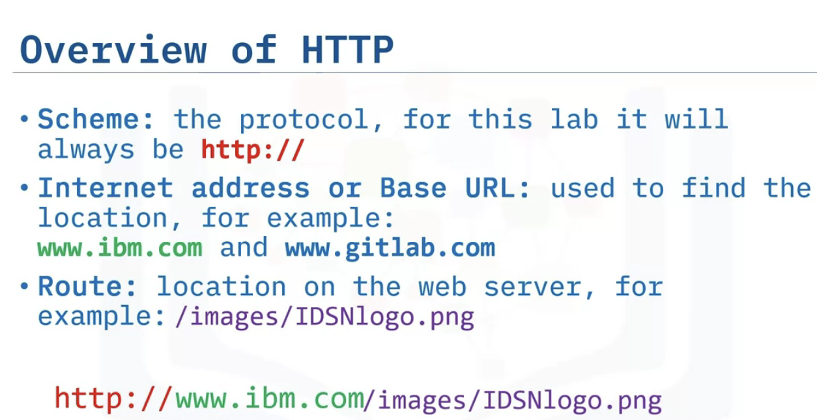
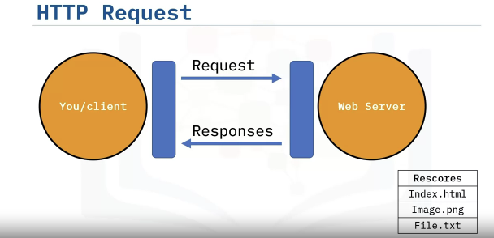
HTTP Protocol & its Overview
URL : Uniform resource Locator , Client –Requests, Web Server- Responses
Requests are served through HTTP protocol which provides JSON format object as response.

Slide 3
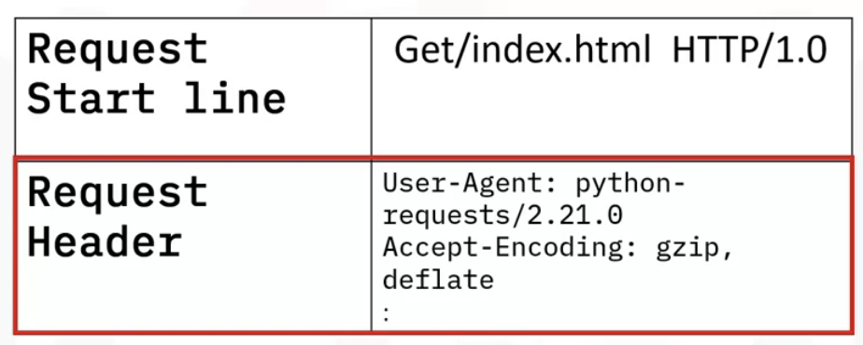
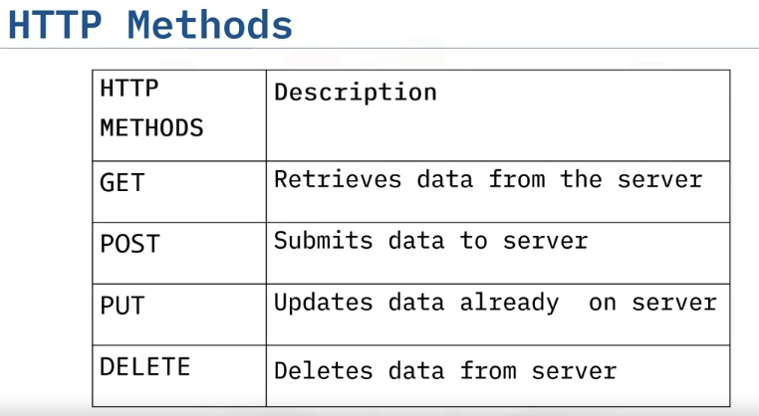
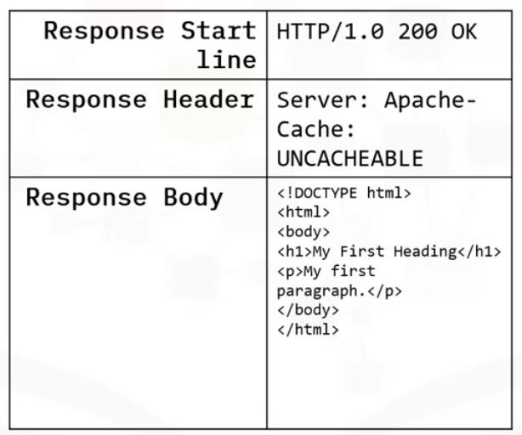
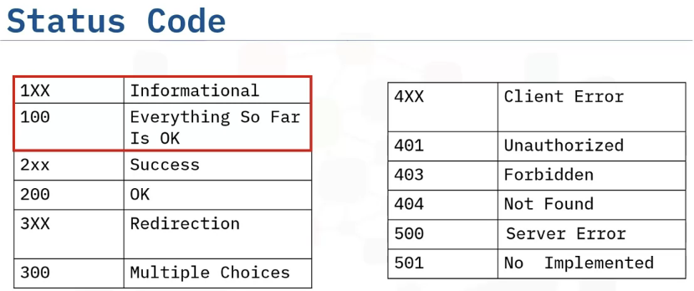
Request Message

Slide 4
REST API, Web Scraping & Working with different File Formats
REST APIs & HTTP Requests – Part 2

Slide 5
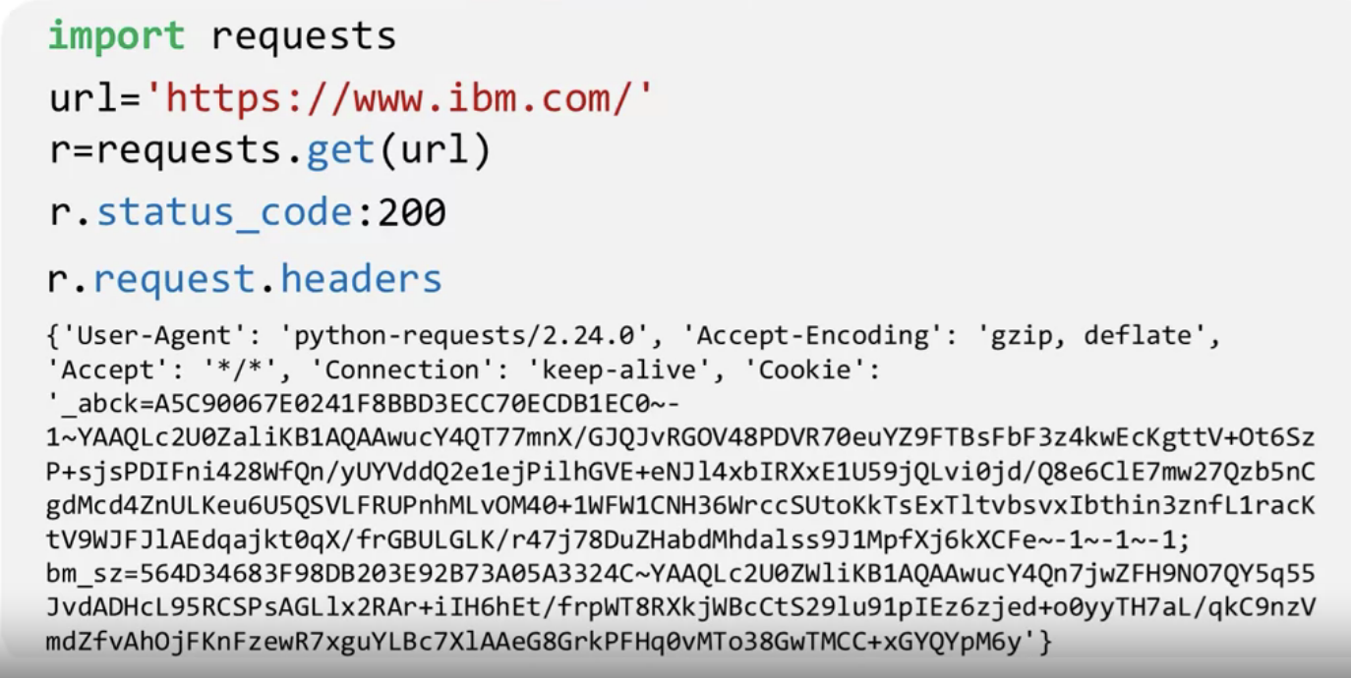
HTTP using Requests Library in Python
Outline : Requests in Python, GET requests, Post requests
Requesting IBM page
Status code=200, page is OK , and requesting headers

Slide 6
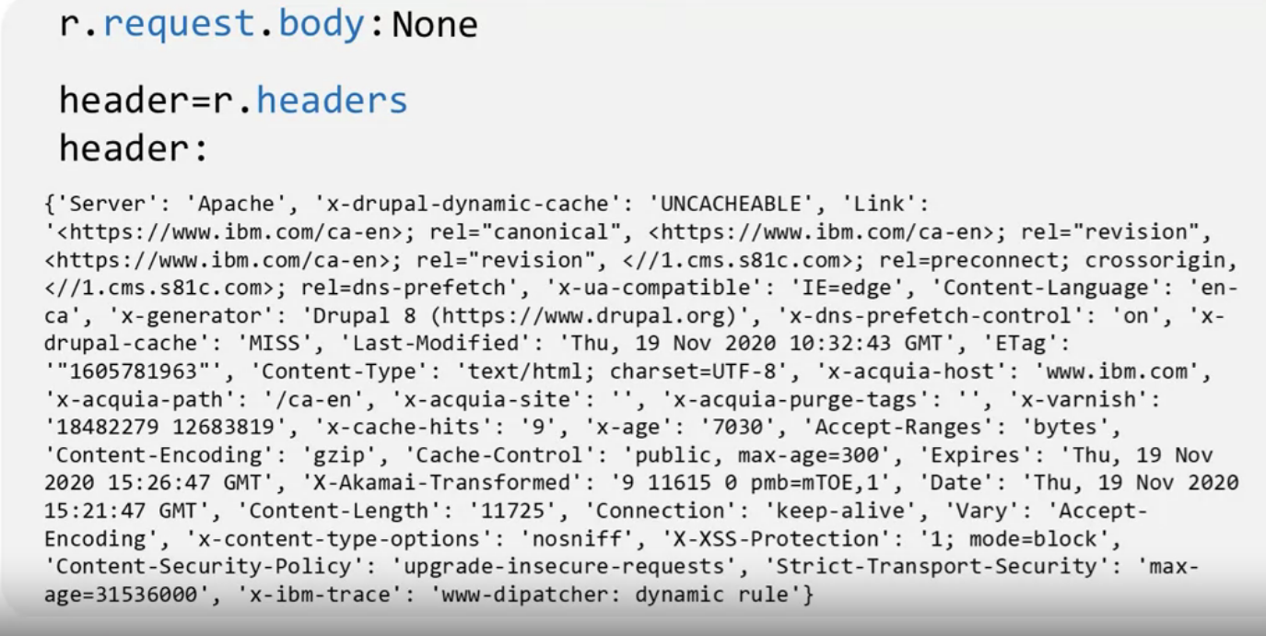
Receiving response as a dictionary

Slide 7
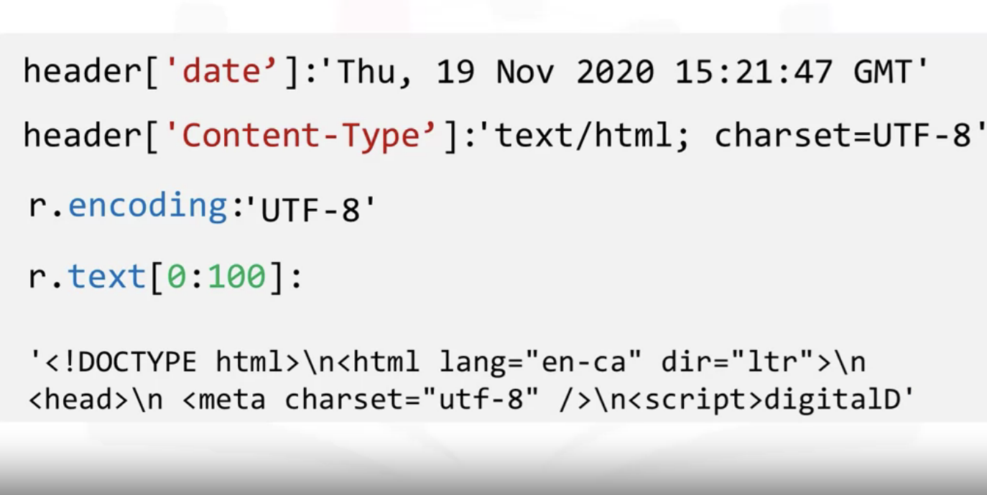
r.text[0:100] = reviewing the first 100 characters,
UTF-8= variable-length character encoding standard used for electronic communication

Slide 8
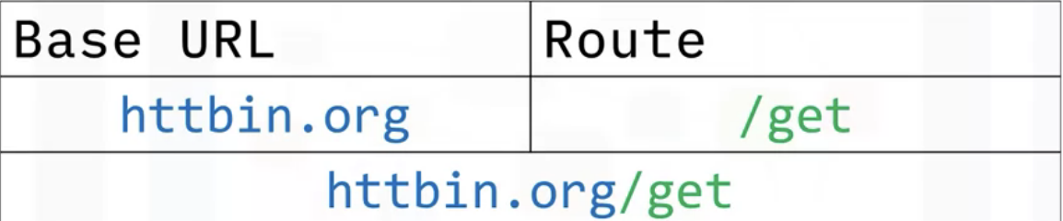
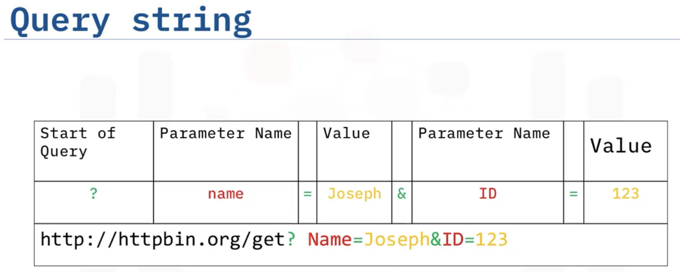
GET Request
As a part of a GET request we receive a Query string

Slide 9
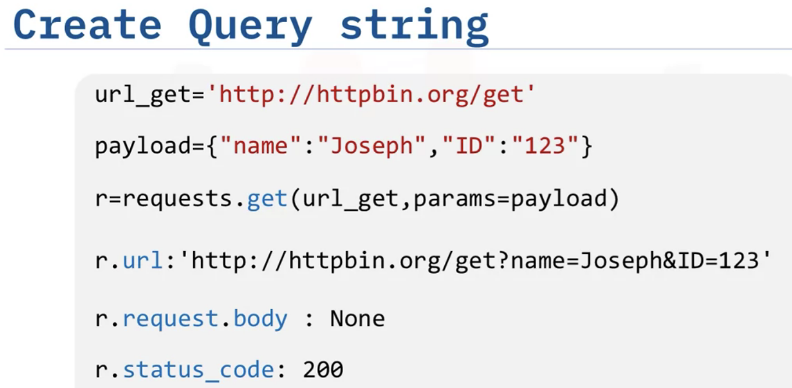
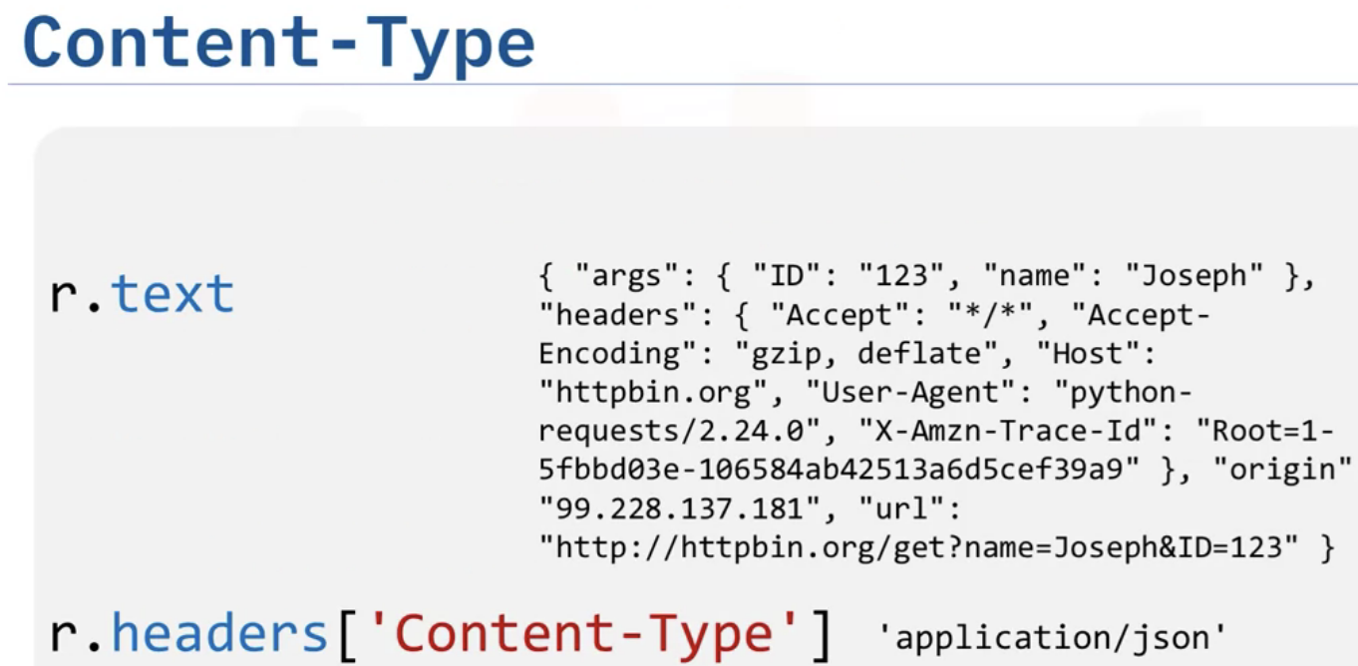
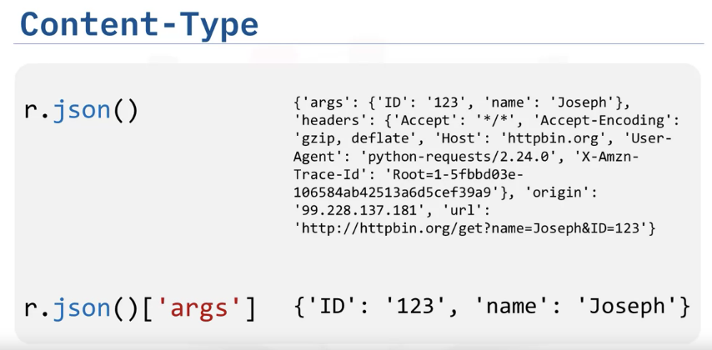
We can explore JSON Dictionary arguments as below

Slide 10
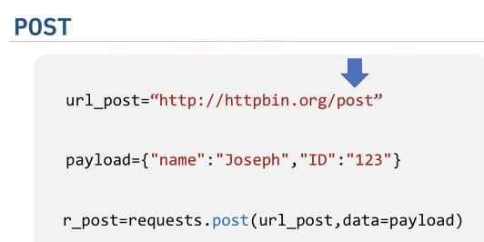
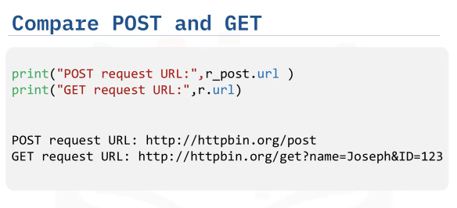
POST Request
Chnaging route to post in order to make a POST request
Comparing GET & POST request, there is no Name or Value Pair in its URL.
We have Payload Dictionry using it, we have to use
POST function

Slide 11
